Slide 1


Slide 2
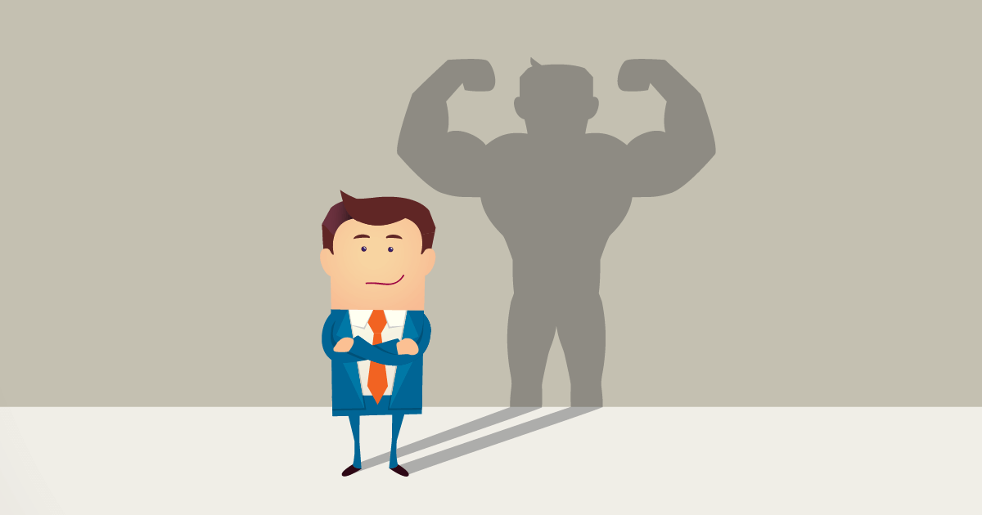
INTRODUCTION
Self esteem affects basically every aspects of a person’s life i.e.
Dressing
Attitude
How we communicate and relate with others

Slide 3
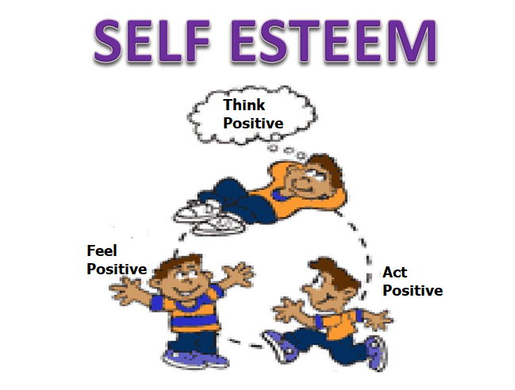

Slide 4
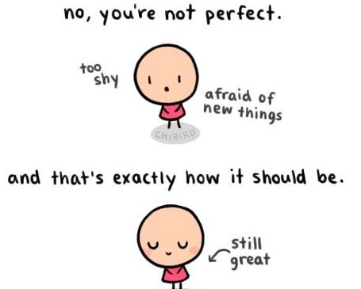
What is Self Esteem?
This is the worth a person places on himself or herself
Notes:
Self esteem is confidence in one's own worth or abilities

Slide 5
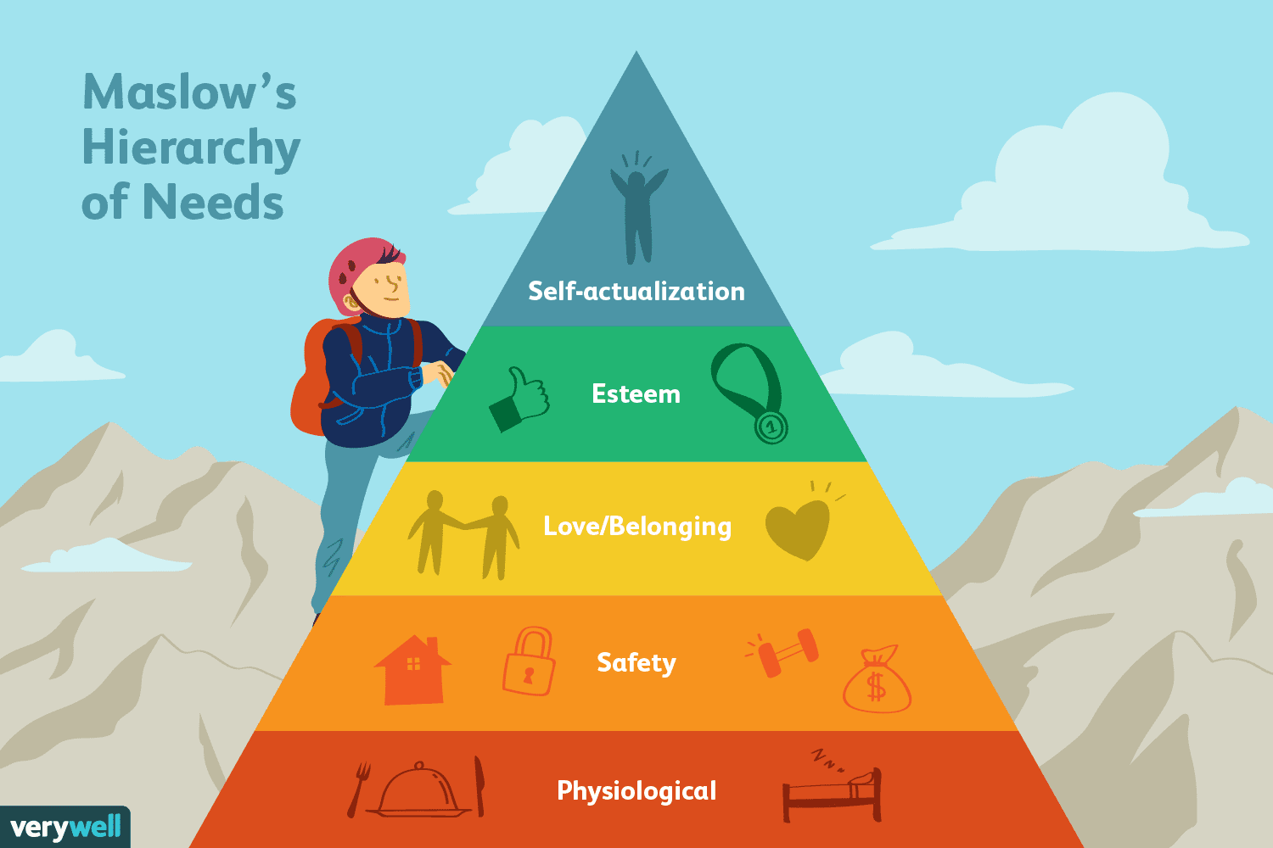

Slide 6
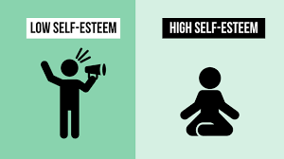
TYPES OF SELF ESTEEM

Slide 7
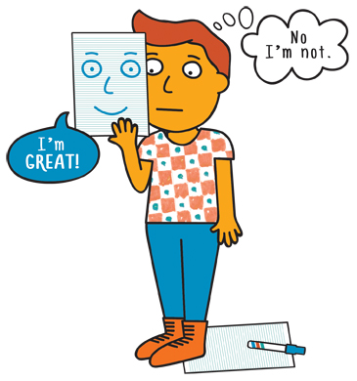
LOW SELF ESTEEM
Low self esteem is about being:
Indecisive
Scared of failure
Always puts others down
Unable to say “No”
Always blame others
Socially awkward

Slide 8
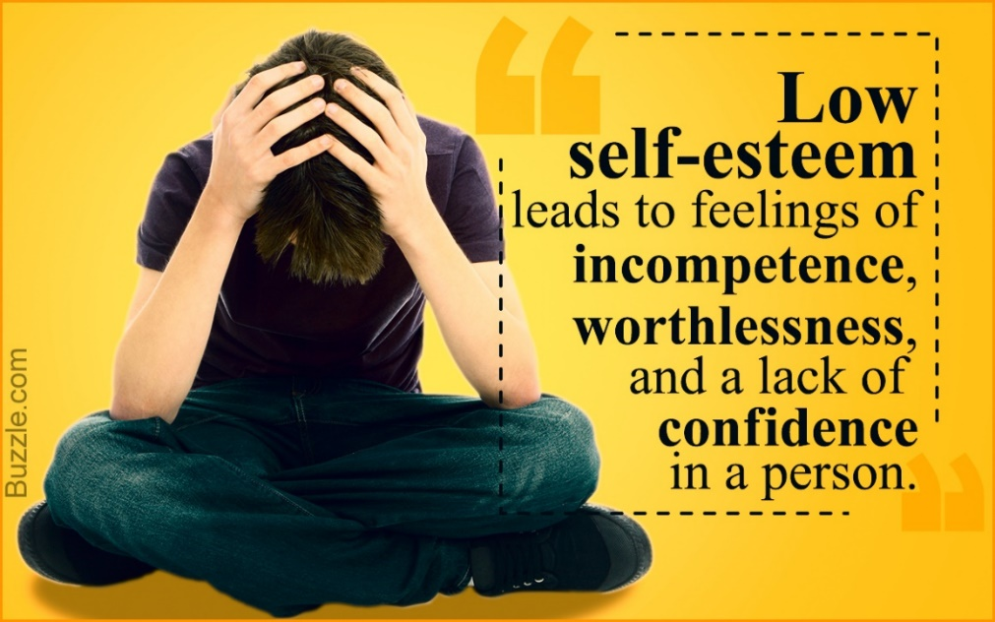
LOW SELF ESTEEM
Inability to genuinely accept compliments
Always afraid to contribute his/her opinions during conversations
Always apologising for everything
Notes:
Pessimism
Feelings of pessimism are a good indication that self-esteem may be suffering. When you don’t feel good about yourself, you have a difficult time feeling good about anything.
Blame
When we’re feeling bad about ourselves, we want to find someone else to blame. We believe that if we’re simply a victim of circumstance, not our own decisions, then there isn’t really anything wrong with us. The problem with this behavior is that it’s a lie and our subconscious knows it. Eventually, it leads to shame
Lack of Boundaries
When a person is dealing with low self-esteem, she may allow others to use them in order to get attention of any kind. She may have difficulty saying no to anyone.
This lack of boundaries brings the wrong people around, and cuts down one’s self-esteem even further
Putting Others Down
They say misery loves company and often an individual with low self-esteem will try to bring others down to their level. This is often done through putting people down verbally
Exaggeration
When our self-esteem is not intact, we have a tendency to exaggerate our lives to others. We may use over-exaggeration to make things appear more troublesome than they really are in order to get sympathy, or to oversell ourselves to superficially inflate our own confidence.

Slide 9
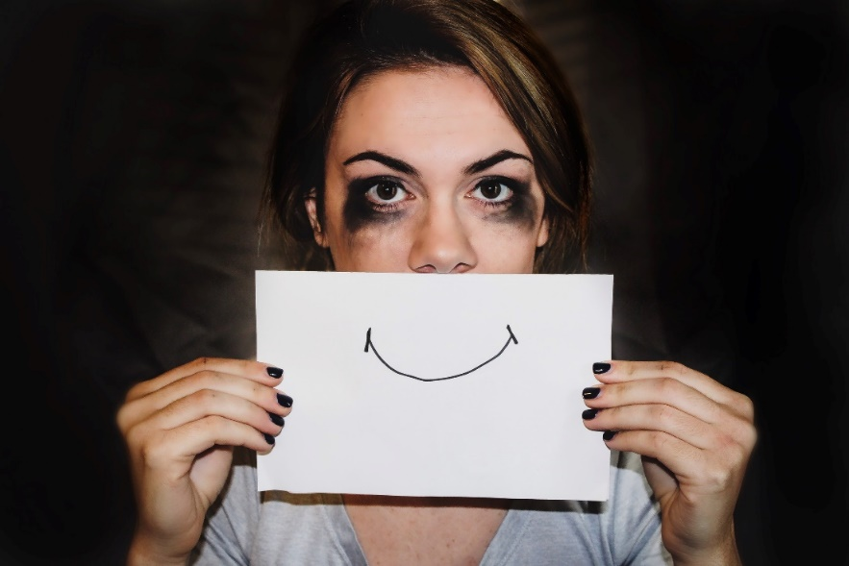

Facts about low self-esteem
44% of girls and 15% of guys are attempting to lose weight.
A Hewlett Packard internal report found that men apply for a job or promotion when they meet only 60% of the qualifications, but women apply only if they meet 100% of them
https://www.dosomething.org/us/facts/11-facts-about-teens-and-self-esteem
Notes:
A whopping 75% of girls with low self-esteem “reported engaging in negative and potentially harmful activities, such as disordered eating, cutting, bullying, smoking or drinking, when feeling badly about themselves”

Slide 10
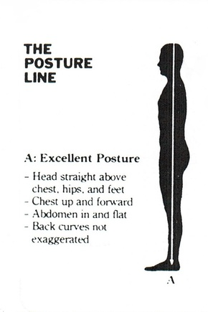
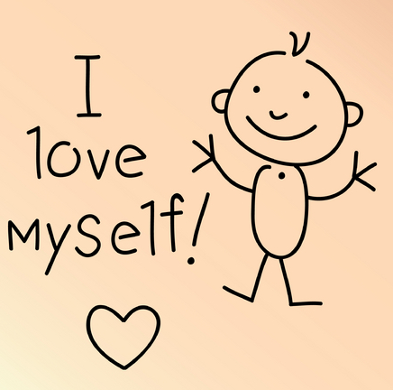
HIGH SELF ESTEEM
An individual with high self esteem:
Has good posture
Is confident
Will not compare him/herself to others
Does not let imperfection ruin his/her day
Will not try to please everyone
Notes:
Does not condemn him/herself when mistakes are made

Slide 11
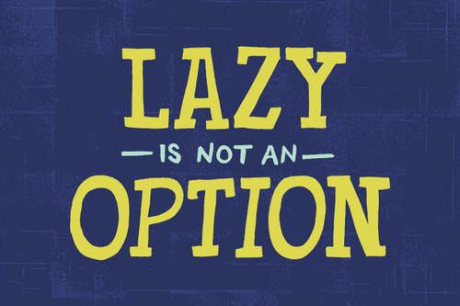


HIGH SELF ESTEEM
Does not fish for compliments
Is not lazy
Does not shy away from taking risks
Has a sense of direction and does not wait to be led
Notes:
Recognizes and accepts a variety of feelings, positive or negatives, and shares them with others if you think it is healthy for the relationship
Enjoys different activities like work, play, walk, relax, and believes balance is important

Slide 12

How is your self esteem?
Answer yes or no to the following questions
There are 2 sections with 10 questions
Keep your answers private to yourself

Slide 13

1st Section
Are you easily hurt by criticism?
Are you very shy or overly aggressive?
Do you try to hide your feelings from others?
Do you try to blame your mistakes on others?
Do you find excuses for refusing to change
Do you avoid new experiences?
Do you fear close relationships?
Do you continually wish you could change your physical appearance?
Are you too modest about personal successes?
Are you glad when others fail?
Notes:
Answer yes or no to the following questions
There are 2 sections with 10 questions
Keep your answers private to yourself

Slide 14
2nd Section
Do you accept constructive criticism?
Are you at ease meeting new people?
Are you honest and open about your feelings?
Do you value your closest relationships?
Can you laugh at and learn from your mistakes?
Do you notice and accept changes as they happen?
Do you look for and tackle new challenges?
Are you confident about your physical appearance?
Do you give yourself credit when credit is due?
Are you happy when others succeed?
Notes:
Answer yes or no to the following questions
There are 2 sections with 10 questions
Keep your answers private to yourself

Slide 15
RESULTS
Add up the yes and no answers in each section
1ST SECTION – The more Yes answers you have, the LOWER your self esteem
2ND SECTION – The more yes answers, the HIGHER your self esteem

Slide 16
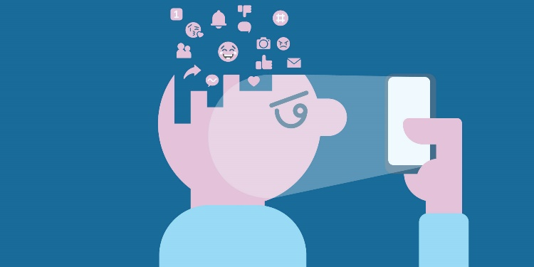
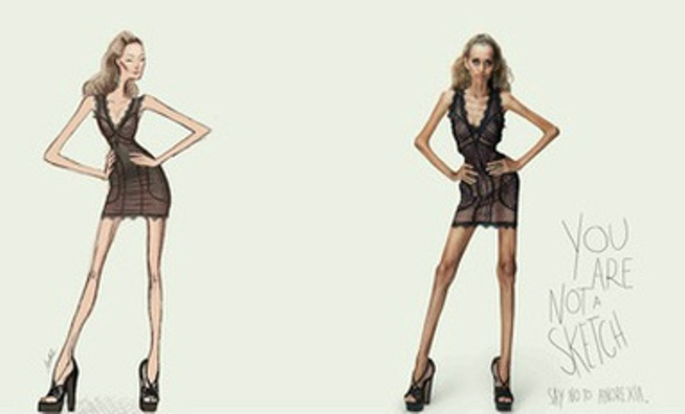

FACTORS THAT CAN AFFECT SELF ESTEEM
Social Media
Unattainable Beauty
Standards
Perfectionism
People Around You
Self-Depreciating Humour

Slide 17


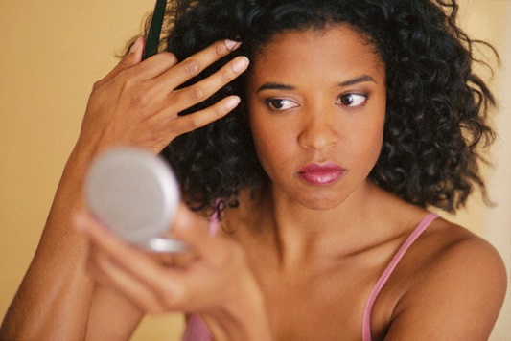

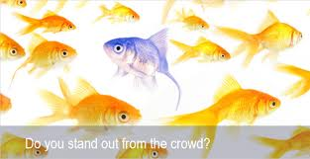
FACTORS THAT CAN AFFECT SELF ESTEEM
What you hear regularly
Role models
Physical appearance
Exposure and environment
Peers

Slide 18
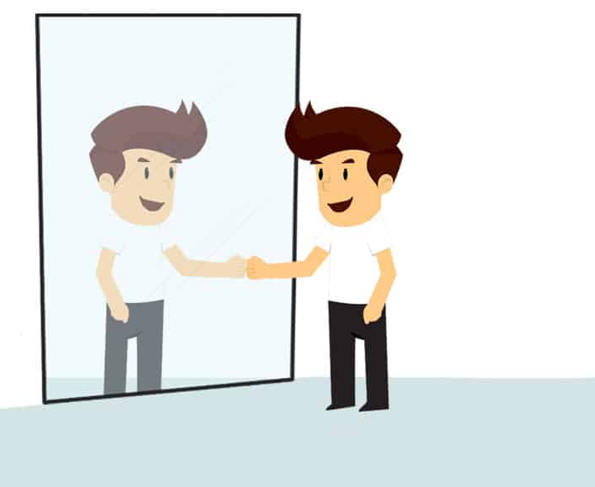
BUILDING YOUR SELF ESTEEM

Slide 19
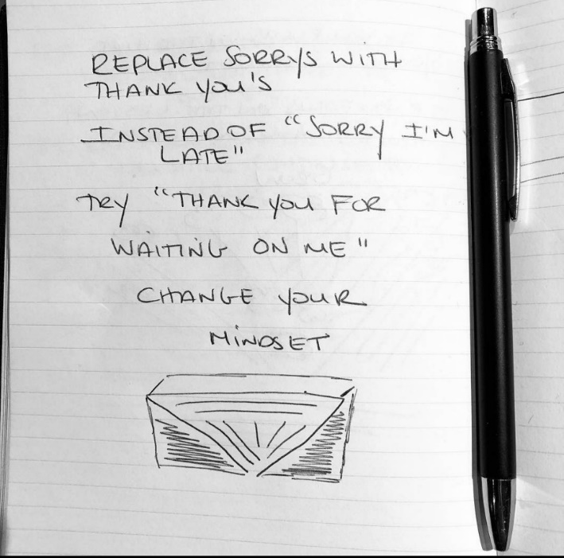

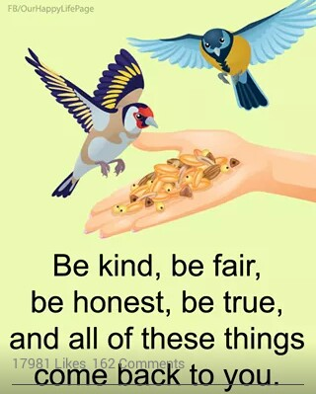
WAYS OF BUILDING UP SELF ESTEEM
Smile more
Be grateful
Give yourself credit for the small things, they add up
Talk to yourself differently and positively
Find a support system
Utilize self-care
Be a good listener
Upgrade your skills

Slide 20
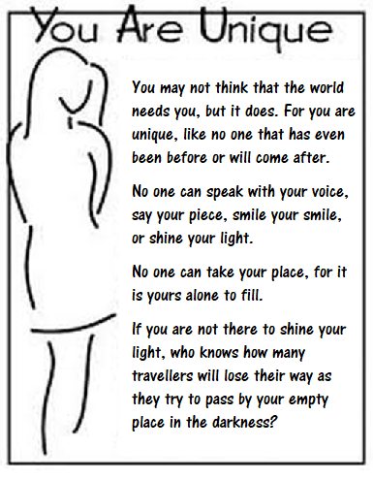

Slide 21
QUOTES
“Wanting to be someone else is a waste of the person you are.” Marilyn Monroe “
The man who does not value himself, cannot value anything or anyone.” Ayn Rand
“I can’t give you a sure-fire formula for success, but I can give you a formula for failure: try to please everybody all the time.” Herbert Bayard Swope

Slide 22
CONCLUSION
What you hear regularly, role models and environment can affect your self esteem but you determine what you want
Paradigm shift can turn your life around

Slide 23


